Slide 1
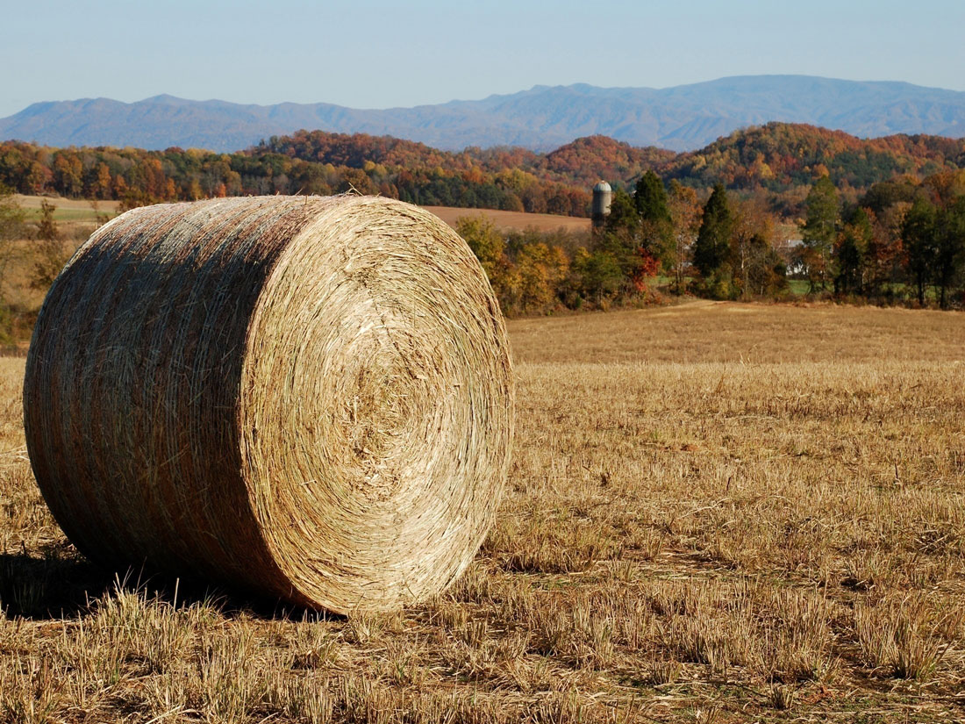
Biofuels on the Landscape: Modeling to balance the environmental footprint of feedstock production on marginal lands
John Field^{1,3}, Thai Dinh², Ernie Marx³, Jess Tryner¹,
and Keith Paustian^{3,4}
¹Dept. of Mechanical Engineering, Colorado State U
²School of Industrial & Systems Engineering, U Oklahoma
³Natural Resource Ecology Laboratory, Colorado State U
⁴Dept. of Soil and Crop Science, Colorado State U
ASA-CSSA-SSSA
Meeting
04 November 2013
Notes:
IGERT Bioenergy program here at CSU
Work in environmental sustainability and carbon accounting for bioenergy production
Funding

Slide 2
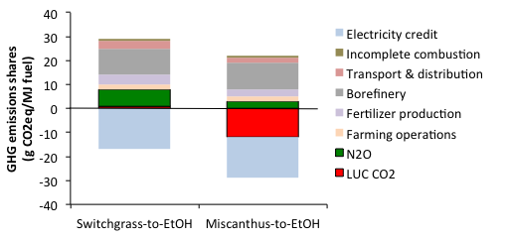
Ecosystem emissions in the biofuel lifecycle
Ecosystem emissions are significant in magnitude…
… and highly variable!
Spatially- Zhang X et al. (2010) GCB Bioenergy
By ‘management’- Davis SC et al. (2013) GCB Bioenergy
Adapted from Wang M et al. (2012) Envi. Research Letters
Notes:
Figure out the details of the Wang et al. 2012 assumptions
1.5% N as N2O-N (their own estimate)
SOM at the international level based on GTAP + CENTURY
Davis swings for Miscanthus, corn based on previous land use history, tillage practice, respectively

Slide 3
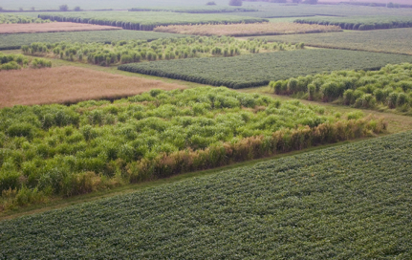
Strategies for cellulosic crop cultivation
Basic strategies for landscape design and management practices poorly understood:
Intensification vs. extensification?
Land sharing vs. land sparing?
Implications for GHG intensity difficult to generalize
Intensification based on increasing N fertilizer rates:

Slide 4
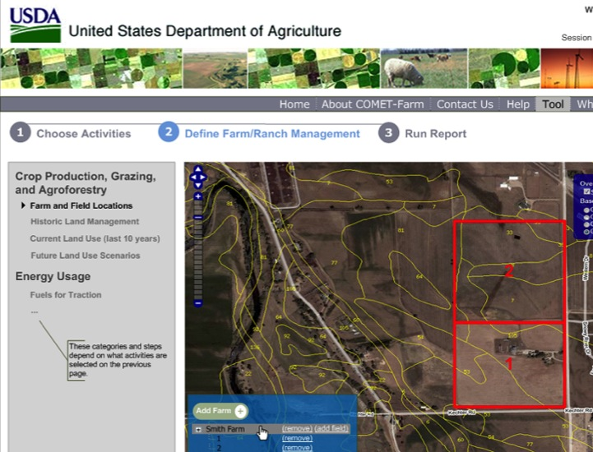
Process-based DSS tool development
Goal: develop a web-based, high-resolution spatially-explicit decision support system for bioenergy feedstock GHG assessment
Individual farm
Regional/biorefinery
DayCent model
Yields, soil C, N2O
Builds on experience with:
COMET web-based ag GHG tools
EPA GHG inventory
Notes:
Mention that it is AFRI-funded!

Slide 5
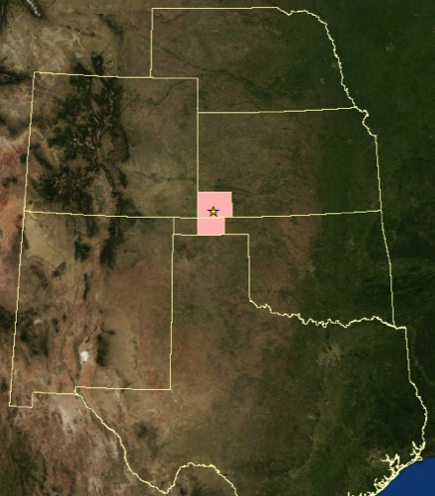
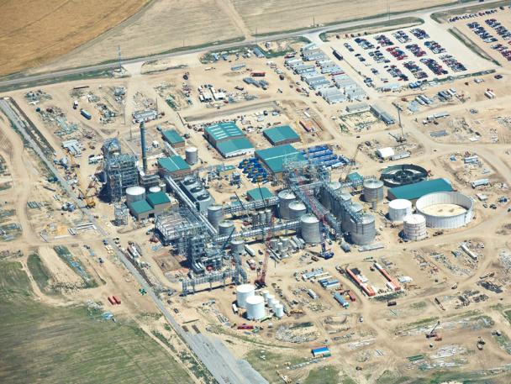
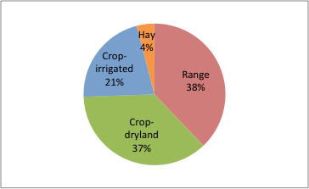
Case study- Hugoton KS
25 MGY cellulosic ethanol plant
(Abengoa)
BCAP program site (switchgrass)
Heterogeneous land use
7-county area modeled @ 4 N rates
Notes:
Emphasize that we have no formal affiliation with Abengoa

Slide 6
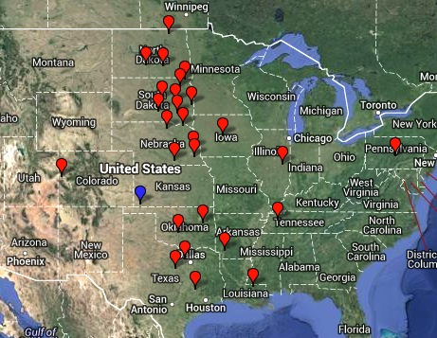
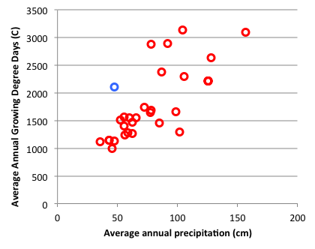
DayCent calibration data
31 sites
80 treatments
Wide range soils, climates, agricultural suitability ratings covered
Notes:
10 studies, 31 sites, 80 treatments, 298 annual points

Slide 7
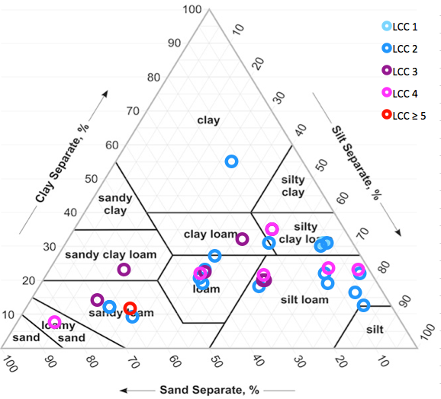
DayCent calibration data
Notes:
10 studies, 31 sites, 80 treatments, 298 annual points

Slide 8
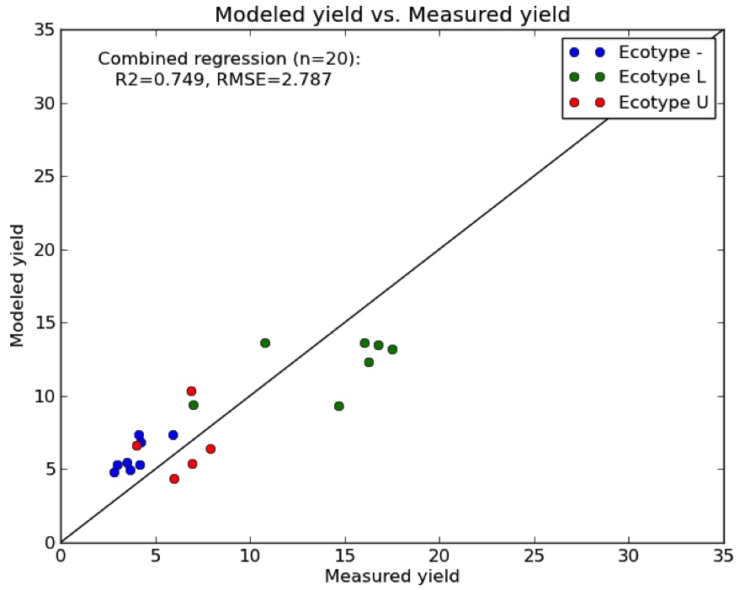
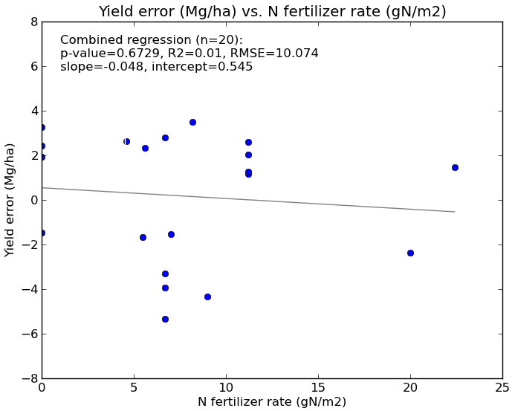
Model validation results
Good overall fit, no bias with N fertilizer rate, soil texture (sand content), or land capability class

Slide 9
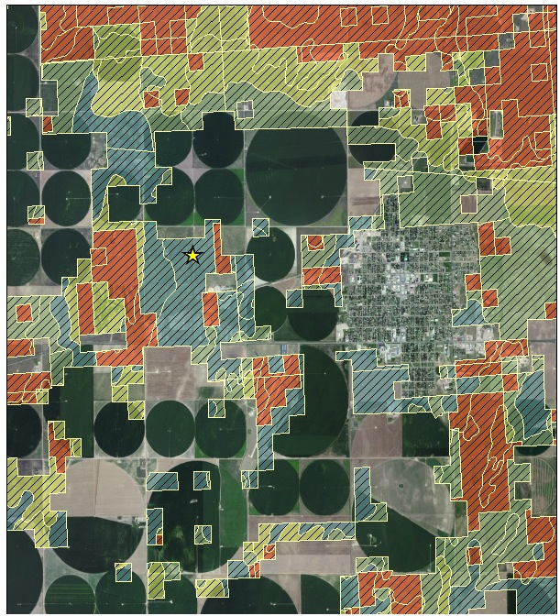
Case study- Spatial data inputs
Nationwide intersect of GIS coverages representing environmental, management variables
Data sources, scale, years covered:
Weather- NARR
32 km, 1979-2009
Soil type- SSURGO
~10 m, NA
Land use- NLDC
30 m, 2006
Irrigation- MIrAD-US
250 m, 2007
Notes:
Note that the map excludes irrigated lands because our analysis did
We are able to account for the covariance between land suitability and land use history to a fairly fine degree

Slide 10
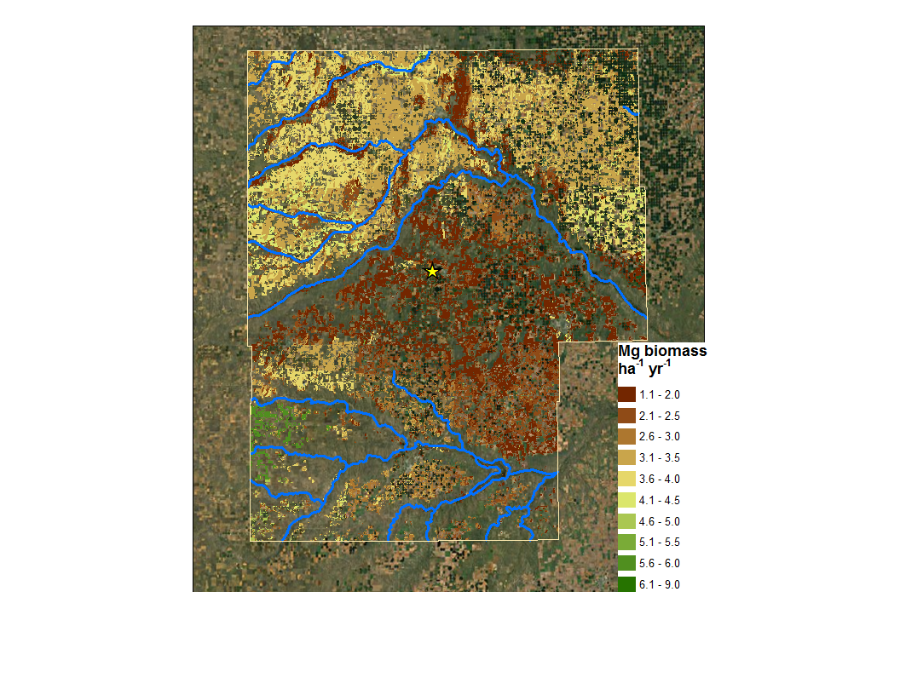
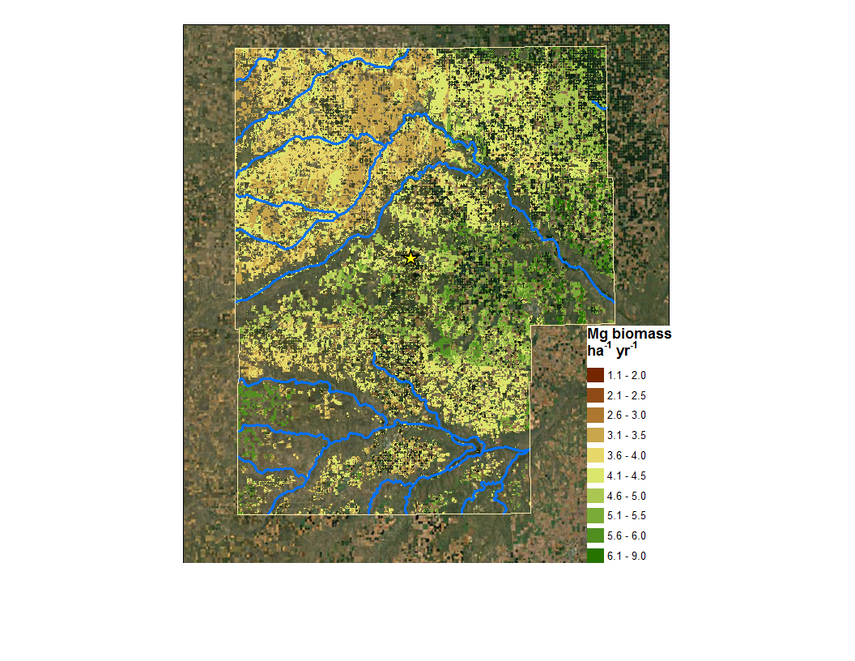
So what drives yield? Location, management
Non-irrigated cropland, no N
45 kg N/ha
Notes:
Huge N response on sandy soils in the middle

Slide 11
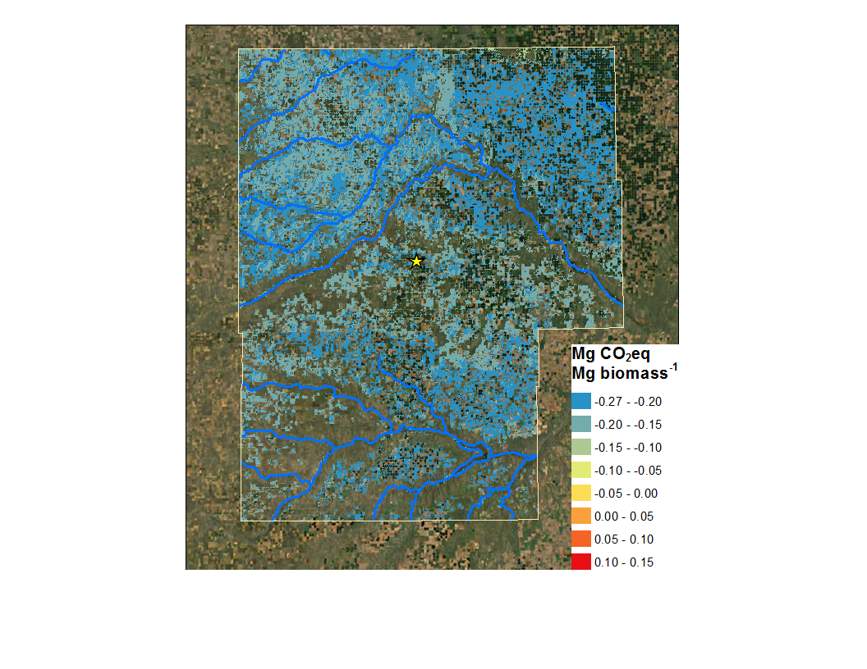
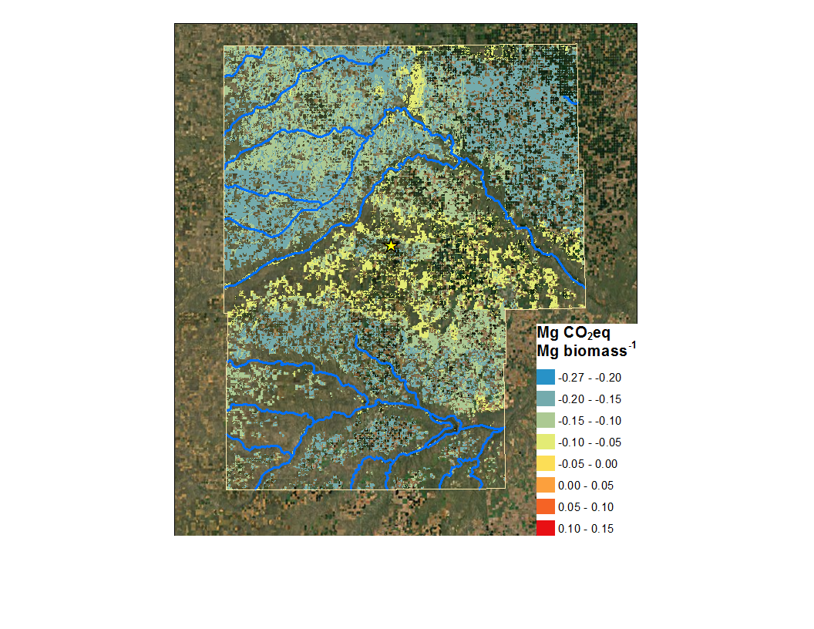
So what drives GHGs? Location, management...
Non-irrigated cropland, no N
45 kg N/ha
Notes:
BIOGENIC GHG INTENSITY

Slide 12
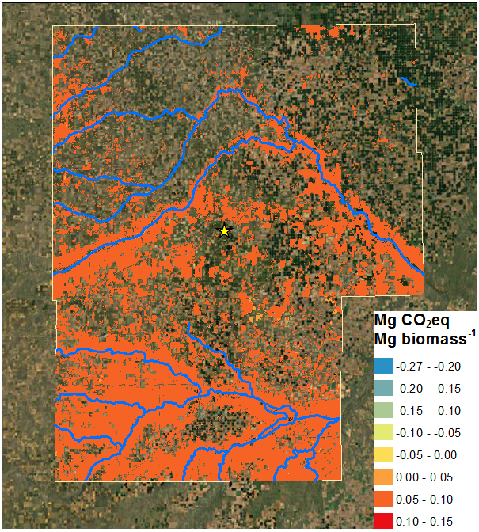
So what drives GHGs? ... and land use history
NI cropland, 45 kg N/ha
NI rangeland, 45 kg N/ha
Notes:
Huge N response on sandy soils in the middle

Slide 13

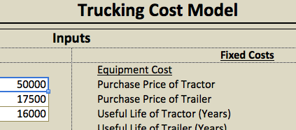

Integrating other tools for policy-relevant results
$/Mg
biomass
$/Mg CO2eq
mitigation
Mg CO2eq/
Mg biomass

Slide 14
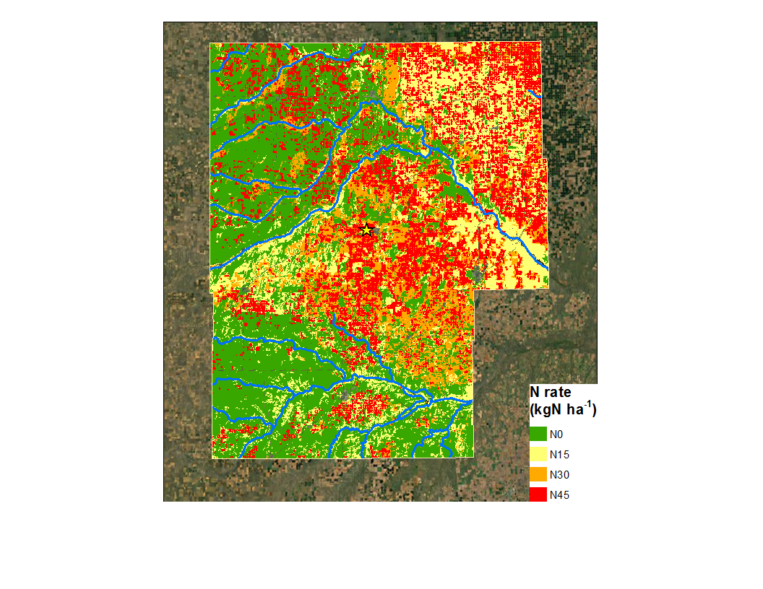
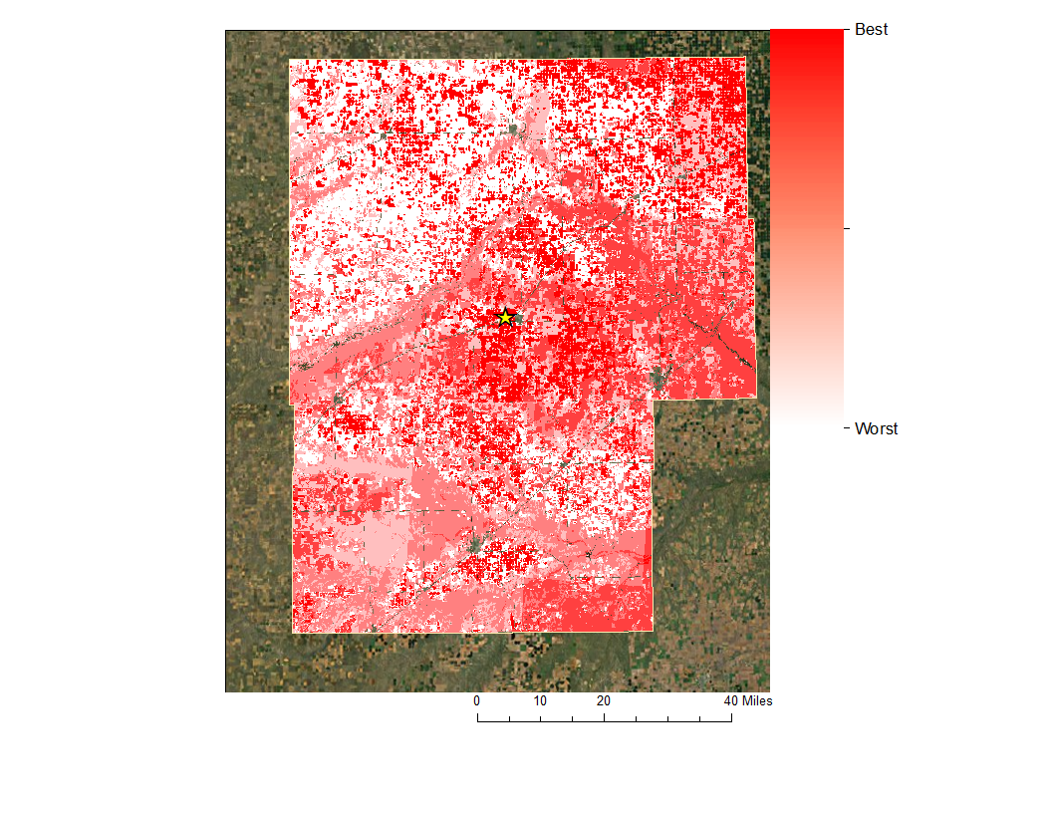
Optimal landscape, cost + SCC x netGHGs
Notes:
Note that we’re using the upper limit of the US interagency SCC estimate

Slide 15
Preliminary conclusions & ongoing work
Ecosystem GHG emissions show wide variation over small spatial scales due to environmental & management variables
Optimal management varies by
Soil type, land use history
Objective function (cost & GHGs often opposed)
Productivity gradients >> transport gradient at this scale
Ongoing work:
GREET integration (inlc. iLUC)
Heurtistic branch & bound algorithm
Exploring GHG mitigation costs for different policy scenarios (e.g., only CRP conversion)
Notes:
Now we have a well-validated, high-resolution assessment methodology
EISA focuses on previously-managed lands- what about new lands in marginal environments?
What about CRP only?

Slide 16




Acknowledgements
USDA-NIFA grant number 2011-67009-30083
MASBioenergy NSF-IGERT program
Colorado Center for Biofuels and Biorefining (C2B2)
C2B2-Chevron graduate fellowship
Natural Resource Ecology Laboratory (NREL)
Cindy Keough & Kendrick Killian- DayCent support
Thank you!!

Slide 17
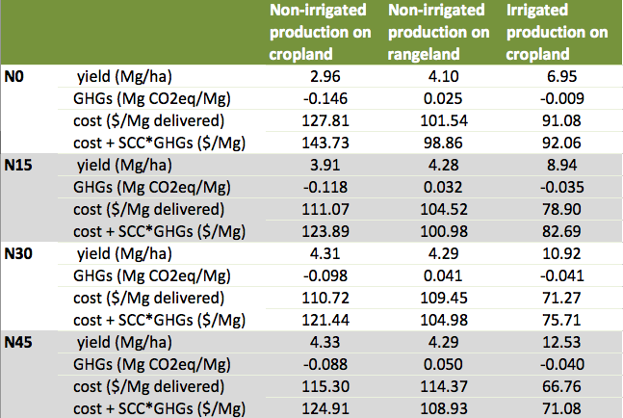
Landscape simulation results- pivot table
Notes:
3-5% of landscape covers Abengoa plant needs

Slide 18
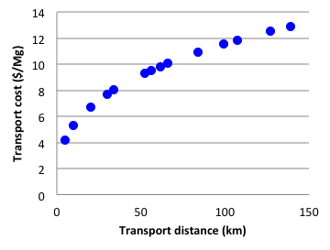
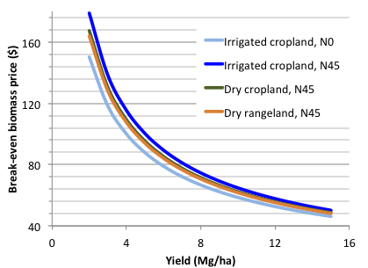
Cost estimates- cultivation and transport

